Slide 1
Anne Hellum, Chikosa Banda, Collins Odote
Engendering, greening and decolonizing legal education:
The master program: «Women’s Children’s and Nature’s Rights in Environmental Governance» (WCNREG)

Slide 2
Strengthening the transformative power of law through legal education
Master program at the Faculty of Law in Nairobi cooperation between staff in the field of women’s law, child law and environmental law from
University of Oslo, University of Nairobi, University of Malawi and University of Zimbabwe.
Cooperation with United Nations Environment Programme, Nairobi
Exploratory approach to environmental governance:
The intersection Exploratory of international, national and local law from the perspective of women, children and nature

Slide 3
Background
Standing on the shoulders of the Southern and Eastern African Center in Women’s Law (SEARCWL) master program in women’s law
Taking lived realities and problems as starting point
From a separatist approach to women’s control, access and use natural resources – land, water, forests etc.
To an integrated approach that explores the rights of women, children and nature in environmental governance

Slide 4
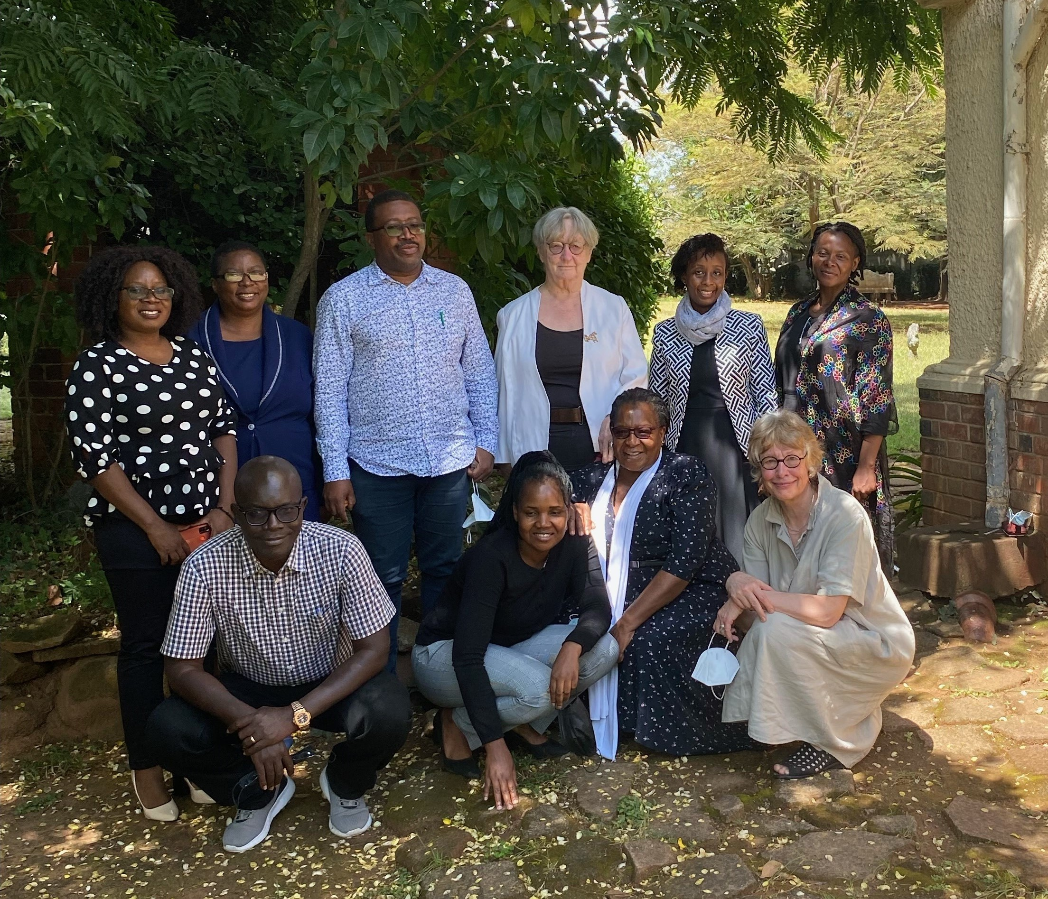

Slide 5
Overall aim: reorientation of legal education
  Engendering
  Environmental law and climate change law needs a subject oriented approach - Infusion of the perspective of women, children and nature
  Greening
  Women’s law and Child law – particularly social and economic rights - need to be infused with environmental protection and climate change
  Decolonising
  Unmake the colonial heritage of land law, water law, environmental law through a bottom up approach that see environmental governance through the lens of women’s children’s and nature’s livelihood rights

Slide 6
Concrete aims
Educate legal expertize in the intersecting fields of natural resource and climate change law and of women's, children's, nature's rights in environmental governance.
Develop practice based legal research that contribute to evidence-based policies that responds to the SDGs in the program’s thematic fields.

Slide 7
Rationale:Need of legal response to the triple crisis in Southern and Eastern Africa
  Malawi, Kenya and Zimbabwe have constitutions and supportive laws, policies and plans
  But challenges remain, including:
    adverse impacts of climate change, increasing water scarcity, biodiversity and ecosystem loss, desertification, cyclical droughts, low resilience to natural disasters, energy crises, food crises, health insecurity, urbanization, degradation of the environment, and a growing gap between the rich and the poor.
  There is urgent need to look critically at the paradox of positive and enabling constitutional provisions co-existing with unrealized rights of women, children and nature in the context of environmental governance in the three countries.
  This programme will benefit Malawi, Kenya and Zimbabwe as it intends to tackle the current development challenges these countries are facing

Slide 8
Rationale: The need to change the way Law is taught in Southern and Eastern Africa
State of the art: No regional research or teaching program in the Southern and Eastern African Region that
  cuts across legal disciplines like natural resource law, climate change law, child law, women’s law, ecofeminist legal theory and human rights law.
  combines law and practice
    with a view to exploring whether and how international, national and local decision-makers and program implementers in areas like environmental law, natural resource law and climate change adaptation include women, children and non-humans.
There is a gap in training and knowledge creation in environmental governance that is grounded within inclusive, engendered, ethical, moral and Southern approaches.

Slide 9
Rationale
The proposed program based on the rationale that there is need to: -
  Disrupt the prevailing existing anthropocentric and androcentric discourses in environmental governance which exclude women, children and nature rights thus failing to effectively respond to the triple crisis.
  Situate women, children and nature at the centre of environmental governance which is critical for addressing the triple environmental crisis.
  Interrogate and deconstruct the prevailing legal and governance paradigms and structures.
  Adopt a novel approach to investigating the triple crisis:- Depletion of environment, climate change and poverty related to lack of access to livelihood resources – calls for careful consideration of the basic livelihood rights of the traditionally marginalised groups

Slide 10
From legal silos to crosscuts and top-down to bottom up
Environmental governance to be taught and studied:
At the intersection of international, national and local level
Across legal areas like environmental law, natural resource law, climate change law, human rights, women’s law and child law.
From a bottom up perspective
  Combining a subject oriented and problem oriented approach.
  Student dissertations based on empirical fieldwork

Slide 11
How law will be taught in the new program/structure and content : Collins Odote
Inter and multi-disciplinary approaches to teaching- both in terms of Faculty and Students
Combination of Class discussions and field research to ensure lived realities capture
Grounded Theory approach to research
Human-rights-based and problem-solving approach to teaching
Paired teaching terms- cross country; south-south and south-north knowledge exchange
Both synchronous and asynchronous approaches

Slide 12
Programme Structure
Curriculum consists of
  8 core courses
  9 electives(choices )
Students to write a dissertation(project paper) on a theme on WSNREG, based on legal and empirical research in home countries( place of fieldwork)
4 semesters: 2 classes, 1 field work and thesis writing, 1 thesis examination and graduation

Slide 13
Core Courses
  Environmental Governance
  Women’s Rights in Environmental Governance
  Children’s rights in environmental governance
  Nature’s rights in environmental governance
  Gender, generational and environmental Justice
  Indigenous Knowledge and Customary Practies in Environmental Governance
  Advanced Research Methods
  Research Project

Slide 14
Elective Courses
  Scientific knowledge for Transformative Policy Advocacy
  Health and Environment
  Women and Children in Ocean Governance
  Soil and Land Governance
  Corporate Responsibility and Env Social Governance
  Sustainable Biodiversity and Equality
  Livelihoods and Climate Change
  Urbanization and Sustainability
  Disaster and Risk Governance

