Slide 1
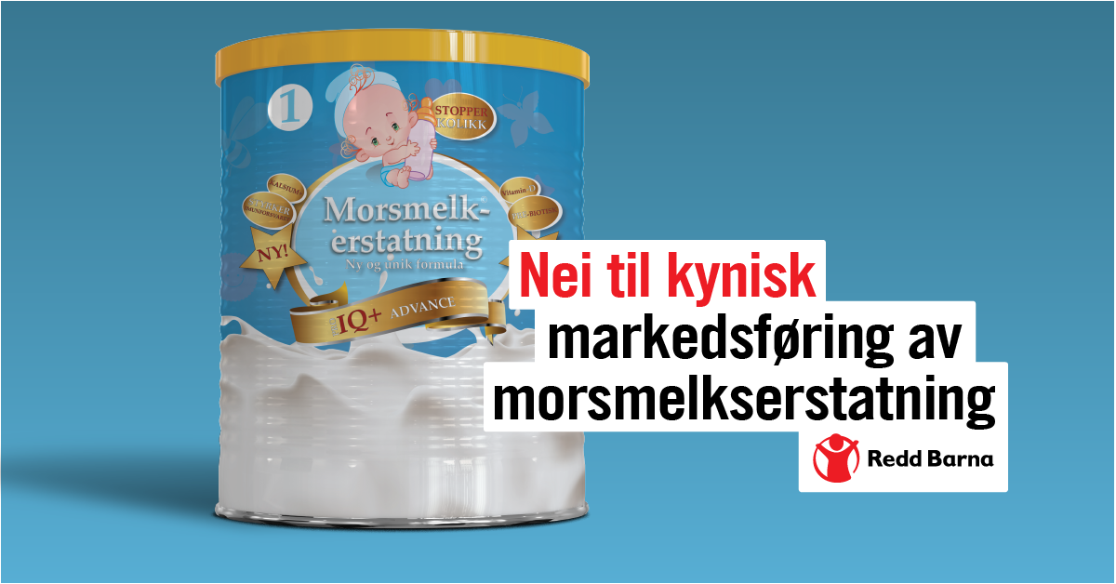
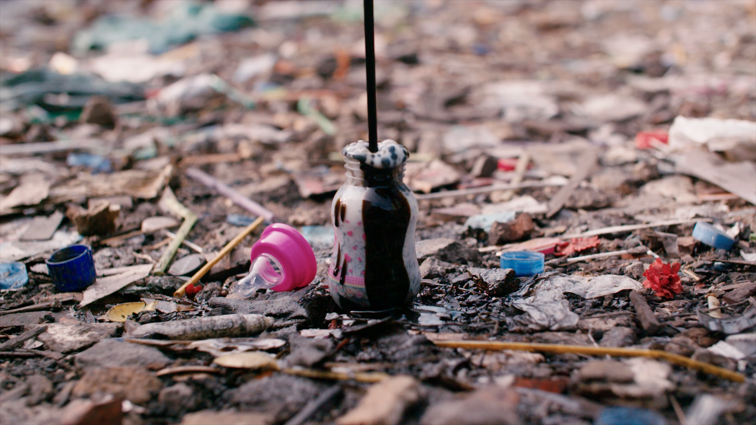

Notes:
Eks på hvordan vi jobber med påvirkning, ofte tenker man kanskje at vi jobber bare opp mot politikere, men man kan også få til store endringer om man påvirker andre steder.
Hvordan jobbe med politisk påvirkning, dette som en case
Hvorfor jobber vi med dette?
Hvorfor er dette viktig for redd barna

Slide 2
823 000​
Notes:
Background: The lancet, 823 000 barn under fem kunne overlevd hvert år om de hadde blitt ammet.
Increasing breastfeeding to near-universal levels could save more than 820 000 lives each year.
Mange grunner til at barn ikke ammes, men én av dem er aggressiv markedsføring
Det har vært et problem lenge, du trodde kanskje det ikke var et problem lenger?

Slide 3
1981 - WHO International Code on Marketing of Breastmilk Substitutes
No promotion to the public
No gifts to mothers or health workers
No promotion in health care facilities or to health care workers​
No free samples or supplies to pregnant women or mothers of infants and young children, their families or health workers
Adequate labels, no pictures of infants or other pictures or text idealizing the use of infant formula
No sponsorship of meetings of health professionals or scientific meetings by companies

Slide 4
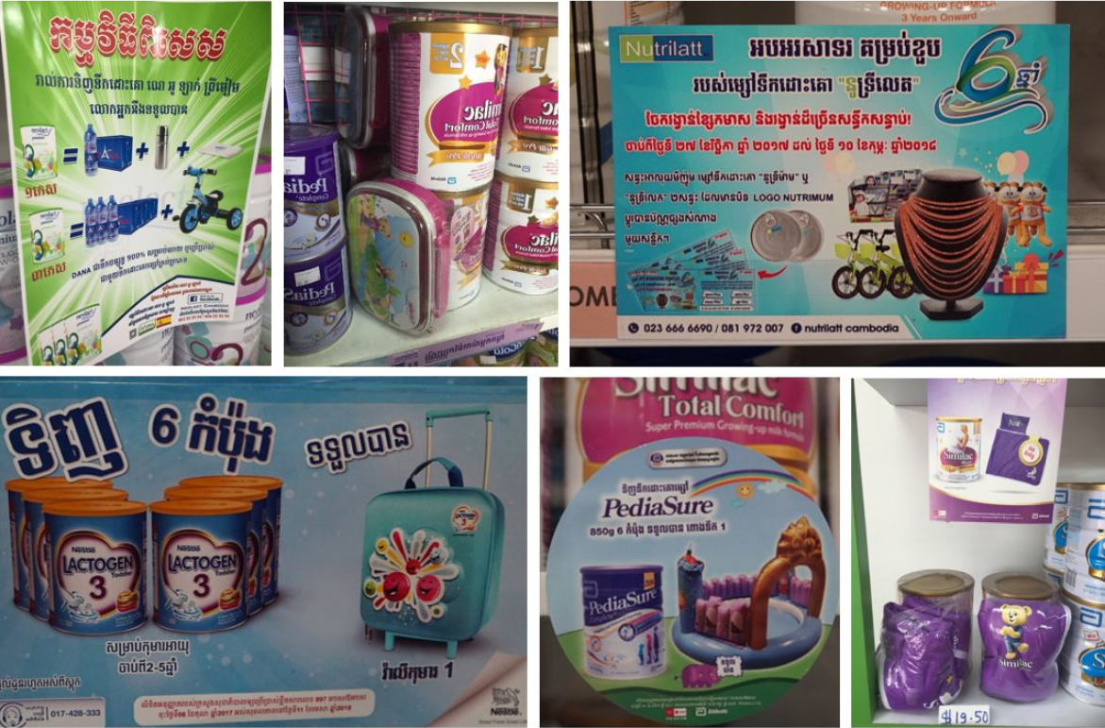

Slide 5
34
8 488
​
87
Notes:
Quiz, what is this?
2017 numbers

Slide 6

Notes:
16 juni
Verdens største statlige investeringsfond
Etiske retningslinjer, produktbasert, adferdsbasert

Slide 7
The Government Pension Fund and human rights
NBIM’s objective:
“The highest possible return with moderate risk”
“We are dependent on sustainable development for a long-term return. We have an interest in companies being able to meet the needs of the present without compromising the ability of future generations to meet their own needs.”
Expectations documents on children’s rights and human rights
The Government Pension Fund’s ethical guidelines
  Serious or systematic human rights violations
  Other particularly serious violations of fundamental ethical norms
Notes:
NBIM:
Expectations document children’s rights launched 2007/8
Revised 2015
Expectations document on human rights 2015/16?
So far, there have been no cases under the Ethical Guidelines relating to unethical marketing. The cases under the criterion on fundamental ethical norms have thus far related natural resources and post conflict and/or occupation

Slide 8
Breastfeeding as a human right
Convention on the rights of the child, article 24, right to health
  General comment 15
  “Exclusive breastfeeding for infants up to 6 months of age should be protected and promoted”
Children’s Rights and Business Principles
“Complying with the standards of business conduct in World Health Assembly instruments related to marketing health”
2016: Joint statement by the UN Special Rapporteurs on the Right to Food, Right to Health, the Working Group on Discrimination against Women in law and in practice, and the Committee on the Rights of the Child in support of increased efforts to promote, support and protect breast-feeding
“States should do more to support and protect breastfeeding, and end inappropriate marketing of breast-milk substitutes.
Breastfeeding is a human rights issue for both the child and the mother”
Notes:
General comment 15, CRC, in 2013. Also specifically mentioned the code
International covenant on Economic, Social and Cultural rights (ICESCR), article 11 (right to adequate standard of living, incl adequate food. General comment 12 (1999) specifies breastfeeding and regulation of BMS
Also ICESCR, article 12, right to health, on infant mortality, but general comment 14 on the right to health does not mention breastfeeding, nor the code
CRBP: Principle 6 on marketing, : Complying with the standards of business conduct in World Health Assembly instruments related to marketing health.
Comply with the standards of business conduct in World Health Assembly instruments related to marketing and health in all countries. Where national law prescribes a higher standard, business must follow that standard.

Slide 9
Children’s rights part of NBIM’s expectations documents
Children’s right to health and survival closely associated to breastfeeding
Investments in BMS companies
91,2 billion
​
​
Notes:
Da vi startet arbeidet vårt, var Nestle den største enkeltinvesteringen til Oljefondet. Utgangen av 2018 femte største enkeltinvestering, aksjebeholdning på 53,9 milliarder, utgjør en eierandel på 2,3 %

Slide 10

We want to make NBIM excecute their role as an active and responsible investor to influence BMS companies to stop aggressive marketing of BMS

Slide 11

Analyze the context. How can NBIM play a role?
Learn from previous successful campaigns targeting NBIM
Get to know NBIM and how they work
Build the argument step by step, based on hard evidence and undeniable facts

Slide 12

Divestment or active ownership?
The Council on Ethics or the NBIM?
Sector initiative or use of expectations document on children’s rights?
Popular mobilization or direct contact with NBIM?

Slide 13
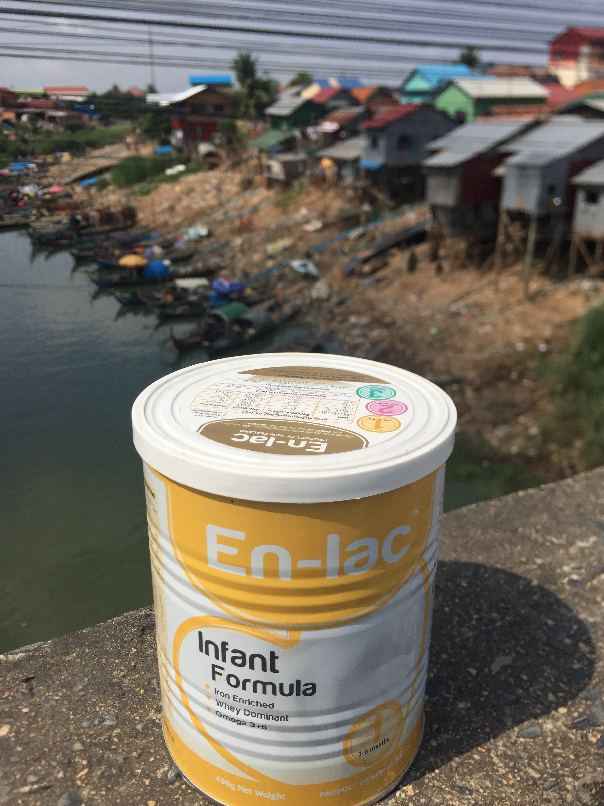
Cambodia January 2018

Slide 14

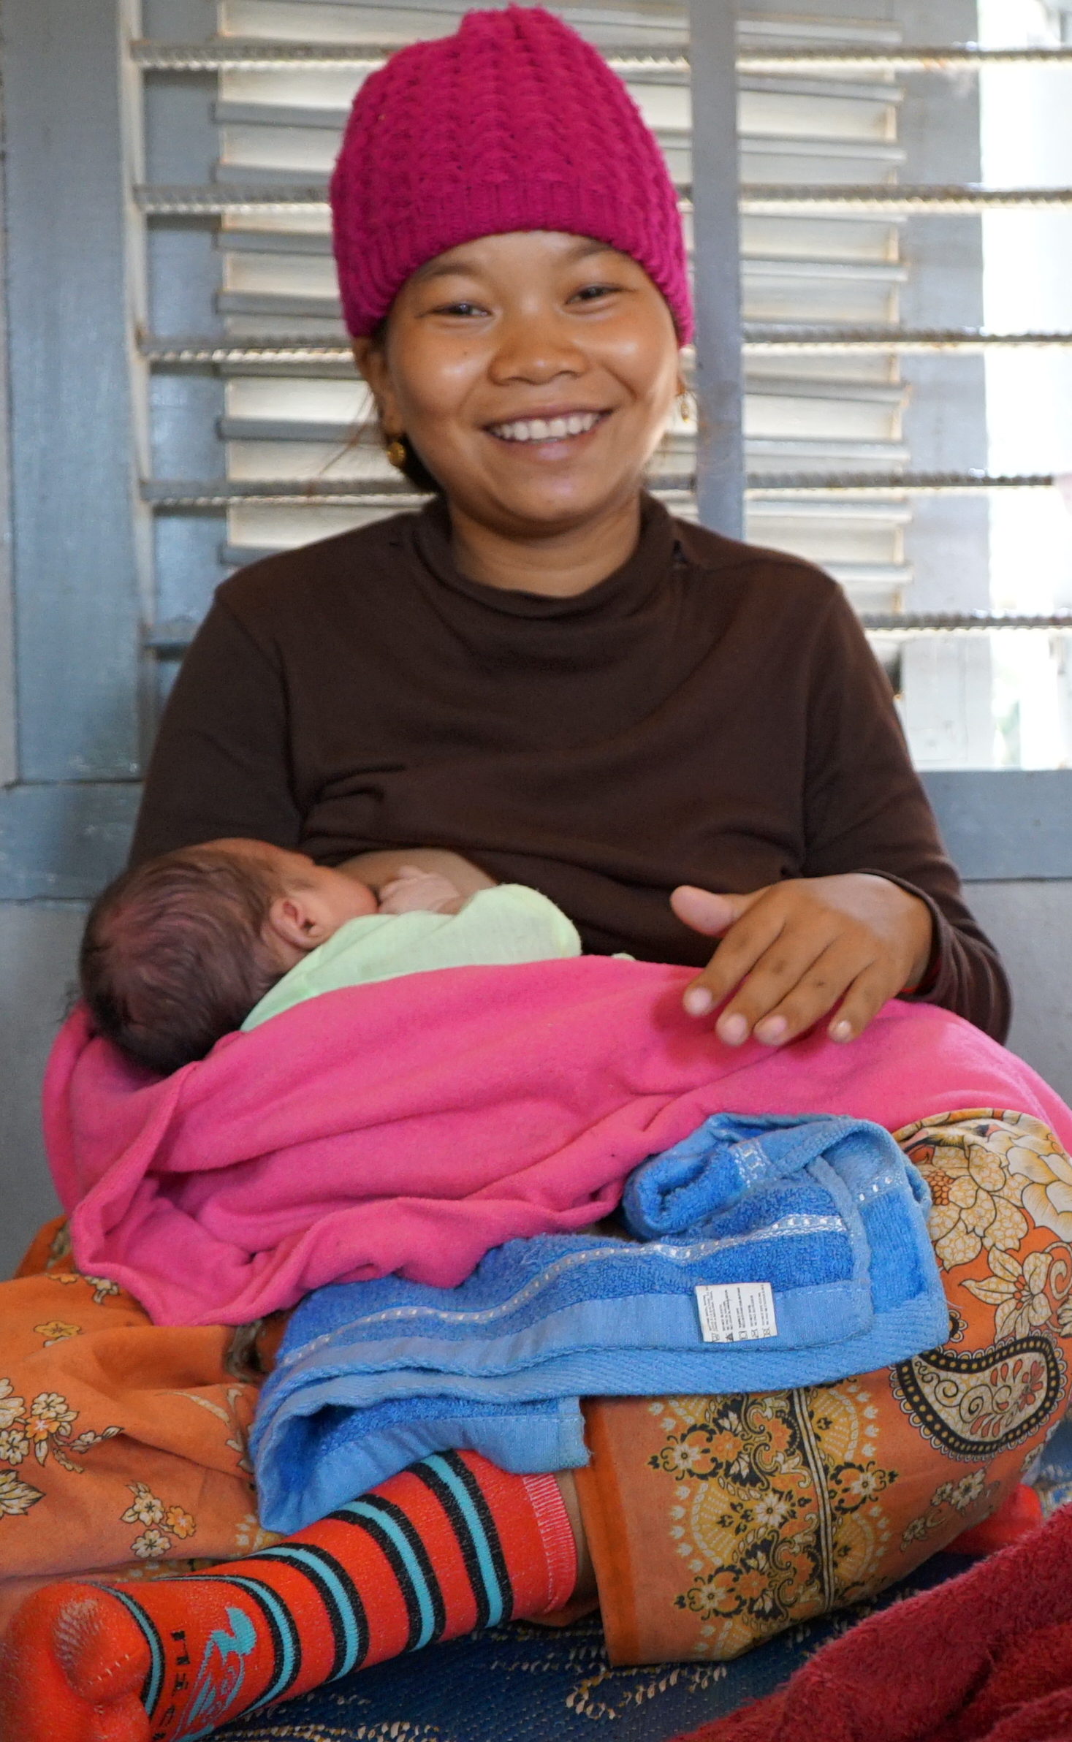
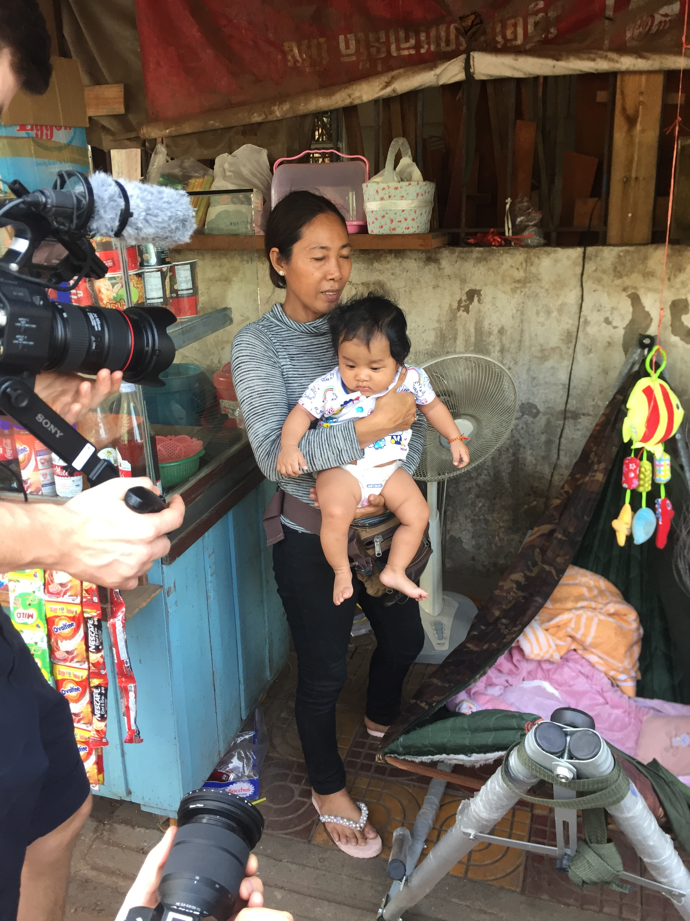
Notes:
Helsepersonell, nybakte mødre, bestemødre, butikkeiere.

Slide 15
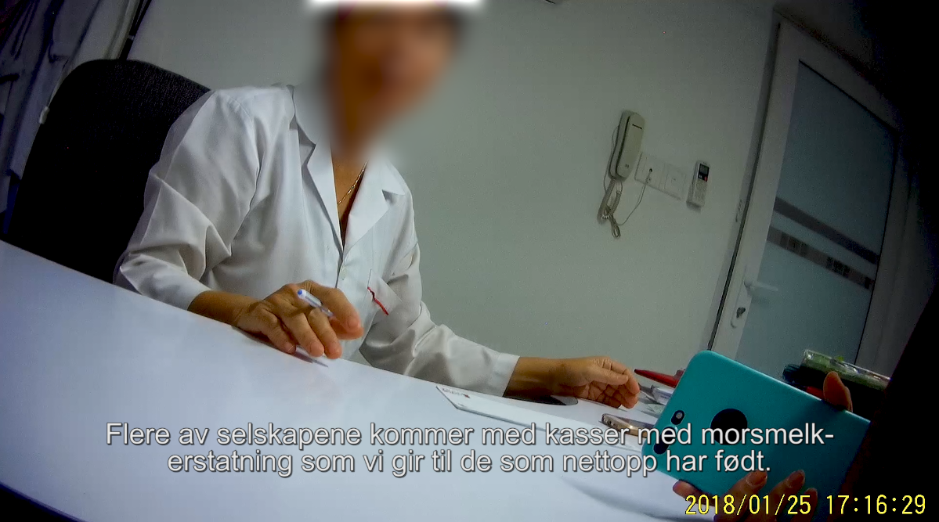

Slide 16
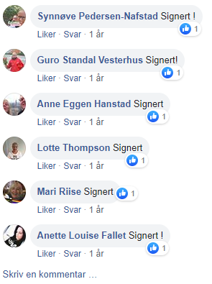


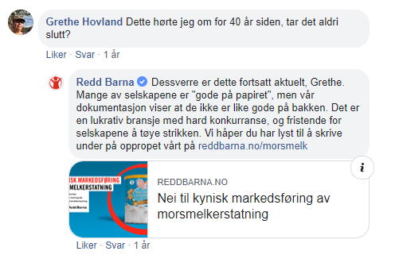
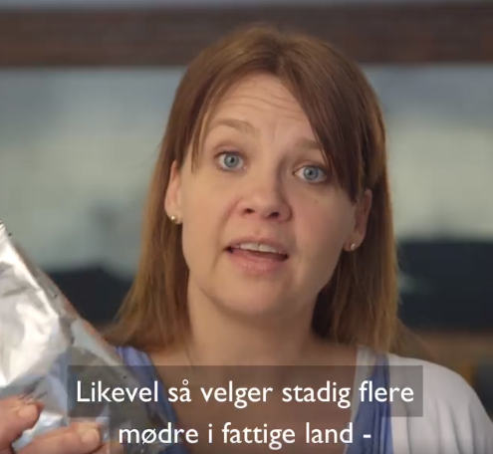
Public mobilization
Notes:
Vi har lang tradisjon for å inkludere et folkelig mobiliseringselement i våre påvirkningskampanjer. Å mobilisere støtte fra folket kan være effektivt nå man skal påvirke beslutningstakere. Morsmelk-kampanjen retter seg ikke først og fremst mot politikere, men mot Oljefondet. Det er minst like relevant å involvere publikum, siden det norske folk er juridiske eiere av oljefondet, og har rett til å bry seg med hva pengene deres blir investert i. Et annet viktig aspekt med å henvende seg ut mot folk er informasjon, opplysning, bevisstgjøring. Vi er bevisste på å gi folk et handlingsalternativ, i dette tilfellet var det en underskriftskampanje.

Slide 17
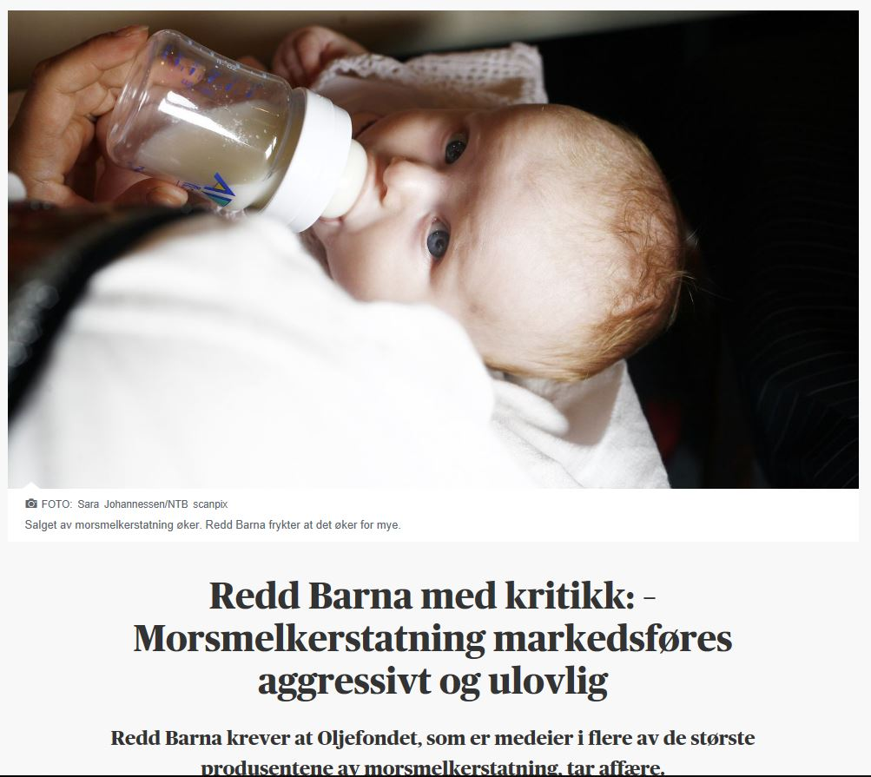
Notes:
Dagsavisen, Aftenposten

Slide 18
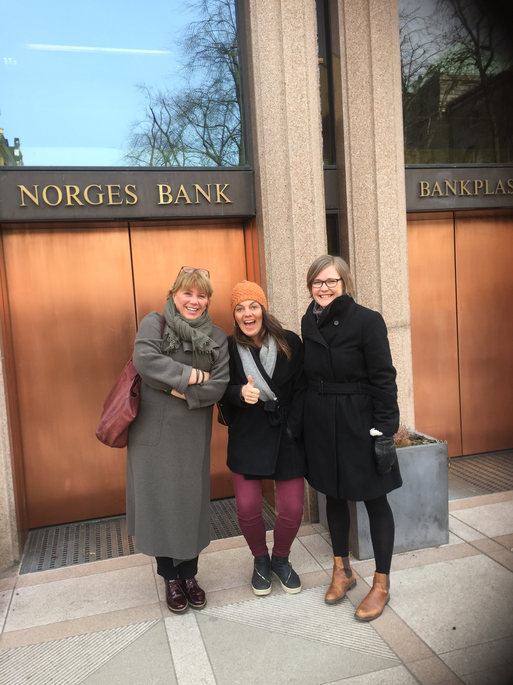
First meeting with NBIM

Slide 19
NBIM February 2019
“In 2018, we initiated a dialogue on responsible marketing with producers of breast-milk substitutes. The aim of the dialogue was to learn more about the companies’ policies for marketing these products, assessing the risks to children’s rights, and monitoring this in their value chains. Our expectations on children’s rights provide a basis for following up responsible marketing at portfolio companies. Breastfeeding is closely associated with child health and survival. Misleading marketing of breast-milk substitutes can pose a risk to children’s fundamental rights.”

Slide 20
What worked?
Internally
  Long-term, thorough work to build our argument
  Solid and waterproof evidence, we knew we were right!
  Strong support from other partners
Externally
  New research from the Lancet 2016
  More transparency from NBIM
  Human rights instruments defined breastfeeding as a human right

Slide 21
A long journey
2015: Statens Pensjonsfond Utland og barns rettigheter​
2016: Breast-milk substitutes and human rights. A review of legal and ethical aspects of non-adherence to the WHO international code of marketing of breast-milk substitutes. ​
2016: Norwegian Bank Investment Managements and children's rights: Suggestions for improved follow up from Save the children​
2018: Don’t push it

